Slide 1
SRM Connect
RA1911003010597: KUSUM P GRANDHI
RA1911003010586: PAVITRA GOLCHA
RA1911003010589: DINESH VERMA

Slide 2
What is SRM Connect?
a platform to unite SRM
bring all opportunities to one place
Share projects and accomplishments with everyone in SRM
Connect with ALUMNI and teachers to gain insights into college happenings

Slide 3
The Problem
Campus has over 40000 people
Inter disciplinary interactions are less
No scope of understanding all events taking place at once
Cant explore all paths
Everyone disconnected due to lockdown.

Slide 4
Our Application
It mainly focuses in
Sharing projects
Work with new people in campus
Get help in exploring new paths and fields
Connect with alumni
Strong student WORK community

Slide 5
Executive Summary
We plan to implement the Agile methodology. It seems to have a great efficiency in the research and development phase and also supports instantaneous updates to have newer versions of the website available to the customer, also we will be able to add new features to the website frequently.
To identify Stakeholder in the project to improve the outcomes of the development.

Slide 6
Selection of Methodology
Waterfall is a Liner Sequential Life Cycle Model whereas Agile is a continuous iteration of development and testing in the software development process.
In Agile vs Waterfall difference, the Agile methodology is known for its flexibility whereas Waterfall is a structured software development methodology.
Comparing the Waterfall methodology vs Agile which follows an incremental approach whereas the Waterfall is a sequential design process.
Agile performs testing concurrently with software development whereas in Waterfall methodology testing comes after the “Build” phase.
Agile allows changes in project development requirement whereas Waterfall has no scope of changing the requirements once the project development starts.

Slide 7
Roles and Methods
Roles:
• Front-End Developer: Kusum Paraag Grandhi
• Back-End Developer: Pavitra Golchha
• Tester: Dinesh Varma
Methods:
• Agile

Slide 8
Stakeholder Management
3.1. Identification of Stakeholders
Students
Teachers
Project Team
Investors
Stakeholder Name | Activity / Area / Phase | Interest | Influence | Priority (High / Medium/Low)
Students | Making profiles and using the website, sending feedback
 |  | High | High | 2
Teachers | Making profiles and using the website, sending feedback | Low | High | 3
Project team | Development, testing and release. | High | Low | 4
Investors | Investing in new ideas | High | High | 1

Slide 9
Communication Plan for Stakeholders
Releasing of the first version of the website for testing
Working on the feedback and improving the website

Slide 10
Project Scope
S.No | Activities In Scope | Activities Out of Scope
1 | develop requirements document | coordinate with college
2 | develop backend code | making it a channel for formal communication
3 | develop frontend code | looking for funding
4 | test backend code
5 | test frontend code
6 | coordinate with various clubs
7 | UI design

Slide 11
Epics
Epic (#) | Epic Description
E1 | Data Analysis
E2 | Display Projects on client side
E3 | Chat on client side

Slide 12
Functional Requirements
Requirement (#) | Requirement Specification | Department | Name of Business User | Status
E1FR1 | As a user, I can share my personal projects | Back End | Back End Developer | Active
E1FR2 | As a User, I can follow my friends. | Back End | Back End Developer | Active
E1FR3 | As a user, I can chat with my friends. | Front end | Front End Developer | Active
E1FR4 | As a user, I can search for a friend. | Front end | Front End Developer | Active

Slide 13
Non-Functional Requirements
Requirement (#) | Category of NFR | Requirement Specification | Department | Name of Business User | Status
NFR1 | Performance | All pages should load within 3 seconds | Front end | Front End Developer | Active
NFR2 | Performance | Search should bring the results less than 7 seconds | Front end | Front End Developer | Active
 | Availability | Application should be available for 24x7 | Back End | Back End Developer | Active
 | Scalability | Registration Service should scale to serve 1000 request per second over 5 minutes timespan | Back End | Back End Developer | Active
 | Confidentiality | All chats should be private. | Back End | Back End Developer | Active
 | Compliance | All the projects should follow community guidelines | Back End | Back End Developer | Active
E1NFR1 | Usability | The website should be easy to | Front End | Front End Developer | Active
E1NFR2 | Reliability | Site should stay online | Server Maintenance | Software Engineer | Active

Slide 14
Infrastructure Requirements
Requirement (#) | Requirement Specification | Department | Name of Business User / Project Team Member | Status
IR1 | Development Machine with 6 GB Ram and 4 Cores | Project Development | Dinesh Kusum Pavitra | Active
IR2 | Code Repository - Github | Technical | Dinesh Kusum Pavitra | Active
IR3 | Cloud hosting - Heroku | Technical | Pavitra | Active
IR4 | IDE – VS Code | Technical | Dinesh Kusum Pavitra | Active

Slide 15
User Story
User Story | Acceptance Criteria | Size of User Story
As a user, I want to follow clubs and/or other users so that I can get updates from them. | Allow users to follow each other. Build a feed based on the user’s following list. | Big
As a user, I want to be connected to the whole community. | Allow users to view publicly shared posts from users and clubs. | Small
As a user, I want to be able to look for and collaborate with other users and/or clubs for a project. | Allow users to find new opportunities. Allow users to post a project idea to invite others to collaborate. | Medium

Slide 16
Project Management Plan
Focus Area | Details
Integration Management | Kusum Paraag Grandhi is the project Lead. He will be handling the Front End development. Pavitra Golchha is the Back End Developer. He will be handling the Website integration and Database management system. Dinesh Varma has been appointed as the Tester. He will be Testing and maintaining the standards of the finished product. Since an Agile process model has been selected for this project. We have the flexibility to test out different models and versions of the final application before it hits the market. We also have allowed ourselves enough flexibility to effectively communicate between the Front-End team and the Back-End Team so that the final product can be produced without too much hassle of data transfers and such.
Scope Management | The target audience of our application are students, everyone in research and teachers. Our end goal is to make sure no one misses any opportunity due to lack of reach. People from outside the college can’t be connected.

Slide 17
Project Management Plan
Focus Area | Details
Schedule Management | Major Milestones for our project will be: Completing Front-End Setting up data base Connecting frontend and backend Making the website dynamic
Cost Management | Estimate Effort Assign Team Budget Control Details Mentioned below
Quality Management | Quality Assurance: Quality assurance will be managed including governance, roles and responsibilities, tools and techniques and reporting Quality Control: Specify the mechanisms to be used to measure and control the quality of the work products

Slide 18
Project Management Plan
Focus area | Details
Resource Management | Estimate and Manage the need People: People & Skills Required Finance: Budget Required Physical: Facilities, IT Infrastructure
Stakeholder | Identifying, Analyzing, Engaging Stakeholders
Communication Management | Determine communication requirements, roles and responsibilities, tools and techniques. [Type of Communication, Schedule, Mechanism Recipient]
Risk Management | Identifying, analysing, and prioritizing project risks
Procurement Management | Adhering to organization procurement process

Slide 19
Effort and Cost Estimation
WBS | Activity | Activity Description | Sub-Task | Sub-Task Description | Effort (in hours/week) | Cost in INR
E1FR1 | E1R1A1 | Web Development | E1R1A1T1 | To create application with connectivity to backend. | 6-8 | 50k
 |  |  | E1R1A1T2 | Data Transferring to and from backend using API calls | 6-8
 |  |  | E1R1A1T3 | Creating a frontend User Interface using React | 6-8
E1FR2 | E1R1A2 | Backend Development | E1R1A2T1 | API Management | 6-8 | 150k
 |  |  | E1R1A2T2 | Hosting | 6-8
E1FR3 | E1R1A3 | Data Analyst | E1R1A3T1 | Using Data and processing for dynamic view | 6-8
 |  |  | E1R1A3T2 | Storage | 5 | 10k

Slide 20
Infrastructure/Resource Cost
Infrastructure Requirement | Qty | Cost per qty | Cost per item
Domain Rights | 1 | 2-5k | 2-5k
Server firm and other hardware | 1 | 150k | 150k
Legal and other government documents | 1 | 200k | 200k

Slide 21
Maintenance and Support Cost
Category | Details | Qty | Cost per qty per annum | Cost per item
People | Tester Frond End Developer Backend Developer | 3 | 20,000,000 | 60,000,000
License | Operating System Middleware IDE | 10 | 10000 | 100,000
Infrastructures | Server, Storage and Machine | 2 | 20000 | 400,000

Slide 22
Identification Team members
Name | Role | Responsibilities
Project Team | Key Business User (Product Owner) | Provide clear business and user requirements
Kusum Paraag Grandhi | Project Manager | Manage the project
Dinesh Varma | Business Analyst | Discuss and Document Requirements
Kusum Paraag Grandhi | Technical Lead | Design the end-to-end architecture
Kusum Paraag Grandhi | Frontend Developer | Develop user interface
Pavitra Golchha | Backend Developer | Design, Develop. Unit Test Services/API/DB
Pavitra Golchha | Cloud Operations | Provision required Services
Dinesh Varma | Tester | Define Test Cases and Perform Testing

Slide 23
Responsibility Assignment Matrix
RACI Matrix | Team Members
Activity | Name (A) | Kusum Paraag Grandhi, Pavitra Golccha, Dinesh Varma | Kusum Paraag Grandhi (Project Manager) | Key Business User
Project Planning | C | R | A | C
App Construction | C | R | A | I
Content Review | A, R | R | I | I
Usability testing | I | C | R | I
Ongoing review of visitors | I | A | R | C
A | Accountable
R | Responsible
C | Consult
I | Inform

Slide 24
WBS With Project Schedule
Module (#) | Activity (#) | Sub-Task(#) | Assignee(s) | Planned Start Date | Planned End Date | Actual Start Date | Actual End Date | Status
Business analyst | Project initiation | Analyze problem points | Kusum | 25-01-21 | 27-01-21 | 25-01-21 | 27-01-21 | completed
 |  | Understand and finalize milestone | Kusum | 28-01-21 | 31-01-21 | 28-01-21 | 31-01-21 | completed
 | Requirements analysis | Analyze gathered information | Dinesh Varma | 01-02-21 | 03-02-21 | 01-02-21 | 03-02-21 | completed
 |  | Define functional requirements | Kusum | 04-02-21 | 05-02-21 | 04-02-21 | 05-02-21 | completed
 |  | Define non-functional requirements | Pavitra | 06-02-21 | 07-02-21 | 06-02-21 | 07-02-21 | completed
 |  | Define infrastructural requirements | Dinesh | 08-02-21 | 09-02-21 | 08-02-21 | 09-02-21 | completed

Slide 25
Developer
 | Development | Front end | Kusum | 18-02-21 | 28-02-21 | 20-02-21 | 02-02-21 | Ongoing | Ongoing
 |  | Back end | Pavitra | 01-03-21 | 20-03-21 | 03-03-21 | 23-03-21 | Ongoing | Ongoing
 |  | Code review | Kusum Pavitra Dinesh | 21-04-21 | 30-04-21 | 24-04-21 | 05-05-21 |  | Not started
 | Testing | Unit testing | Dinesh | 01-05-21 | 10-05-21 | 06-05-21 | 15-05-21 |  | Not started
 |  | Integration testing | Dinesh | 11-05-21 | 20-05-21 | 16-05-21 | 25-05-21 |  | Not started
 |  | User acceptance testing | Dinesh | 21-05-21 | 30-05-21 | 26-05-21 | 05-06-21 |  | Not started

Slide 26
List (Describe) Register
Risk ID (#) | Risk Description | Impact Description
R01 | Server crash | Slow site load due to poor support from database team
R02 | Unresponsive site | browser incompatibility
R03 | Database failure | Losing the personal chat of the user or some of his personal information
R04 | Breach of user data | Users information have been hacked by someone

Slide 27
Managing Risk
Risk ID (#) | Status [Open / Closed] | Risk Appetite [ Accept/ Mitigate/ Transfer/Avoid] | Action | Action Owner | Target Date | Remarks
R01 | Open | Mitigate | Scale the servers to support more traffic | Backend developer | 05-06-21
R02 | Open | Mitigate | Optimise code | Frontend developer | 05-06-21
R03 | Open | Mitigate | Restore data from backups or expand storage | Backend developer | 05-06-21
R04 | Open | Mitigate | Reset user password immediately and notify the user about the breach | Backend developer | 05-06-21

Slide 28
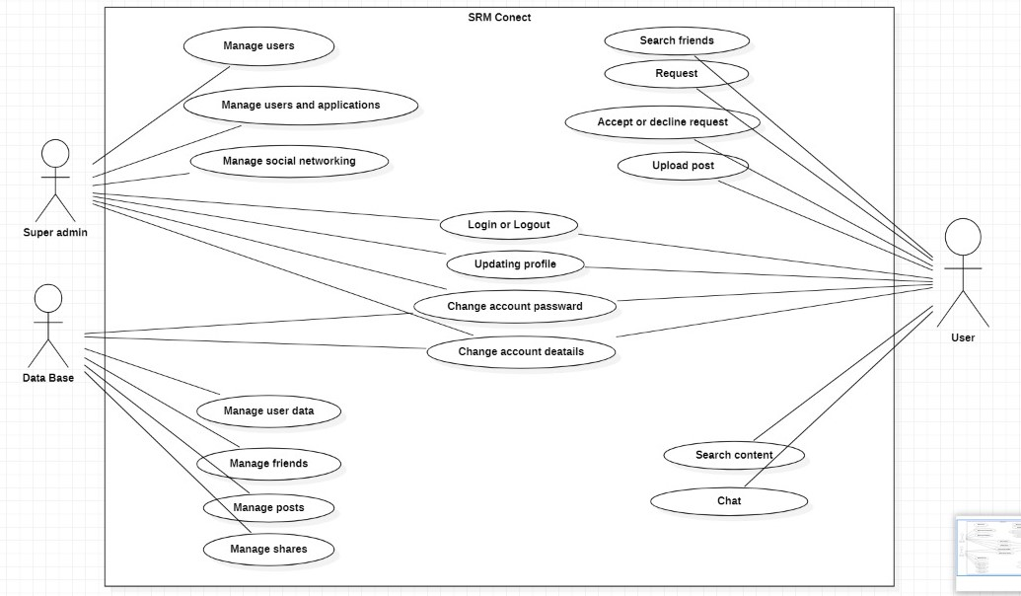
Use Case Diagram

Slide 29
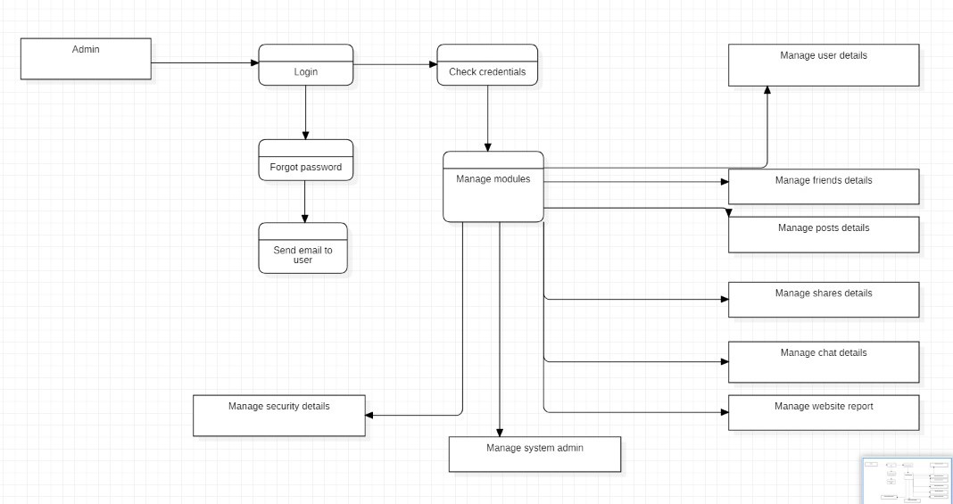
DFD Diagram (process)

Slide 30
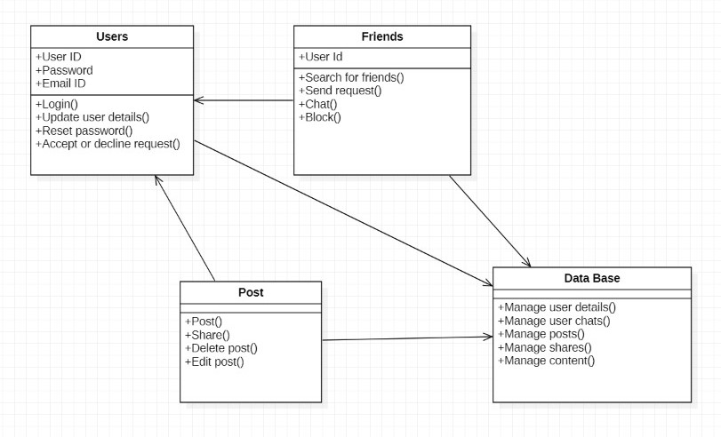
Class Diagram (Applied For OOPS based Project)

Slide 31
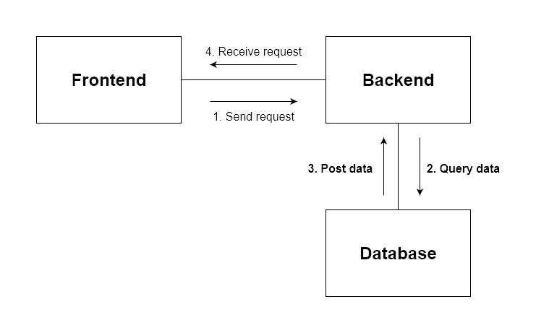
Collaboration Diagram

Slide 32
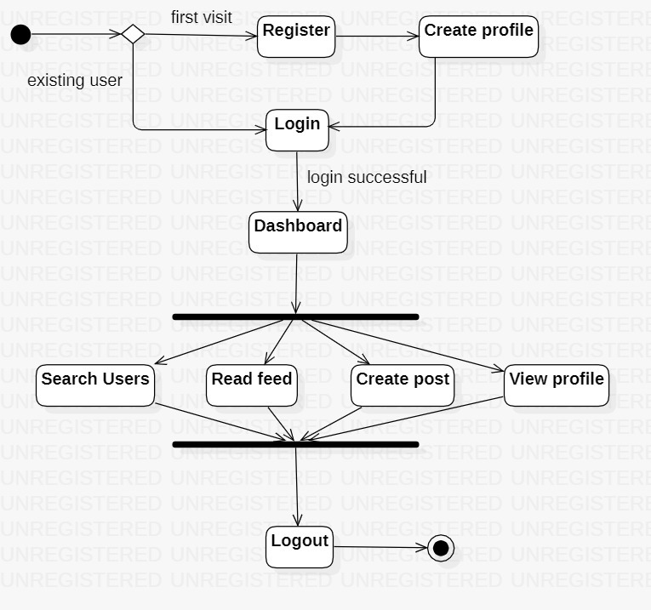
State Diagram

Slide 33
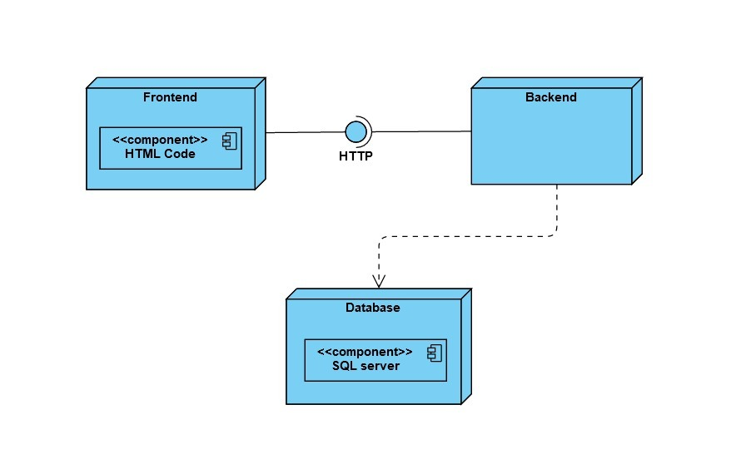
Deployment Diagram

Slide 34
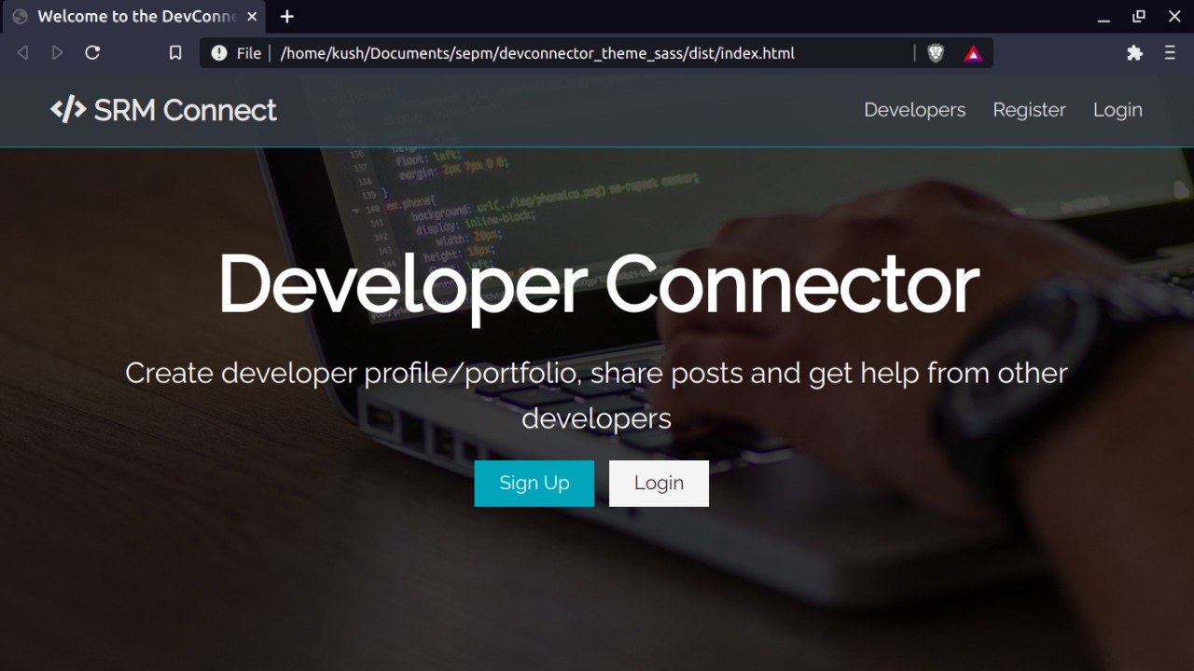
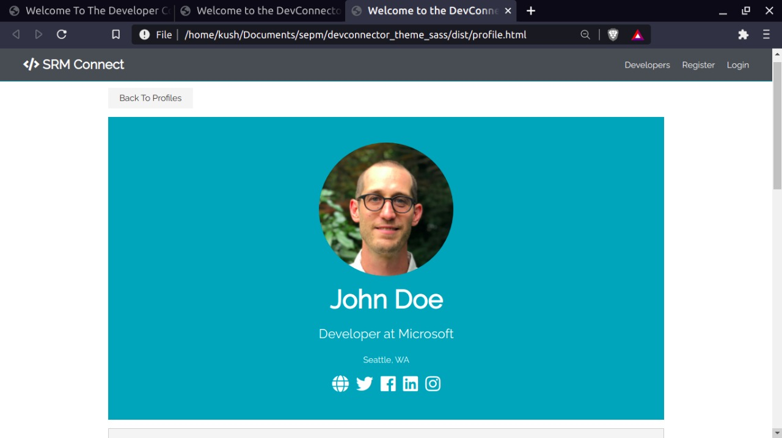
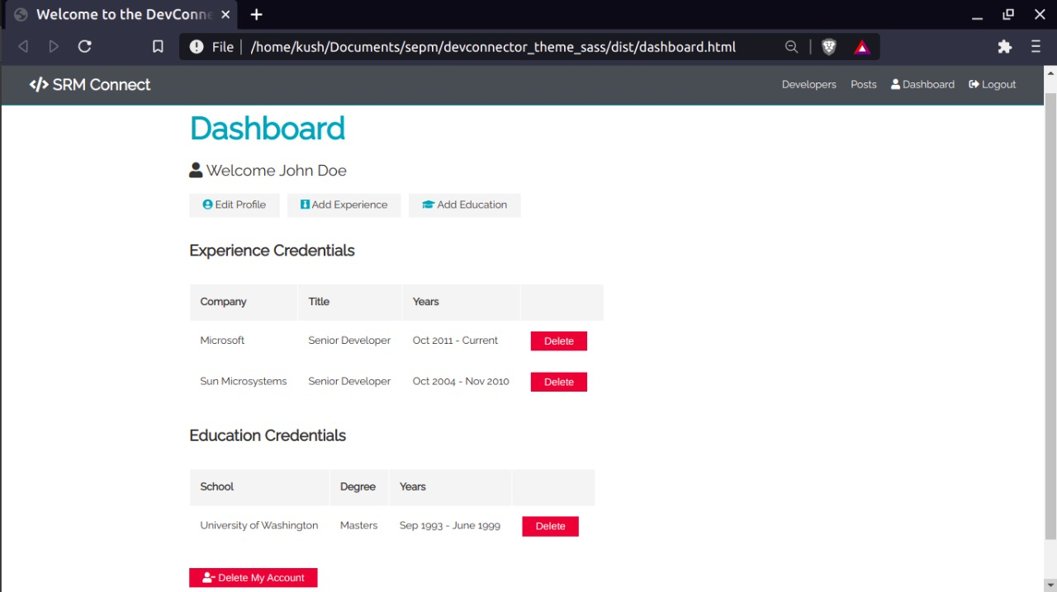
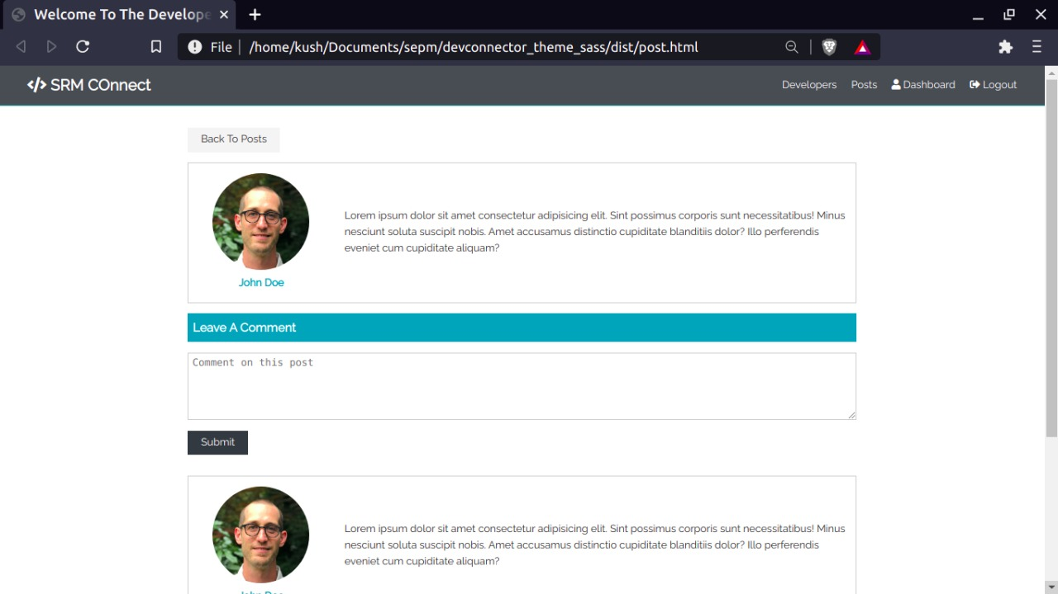
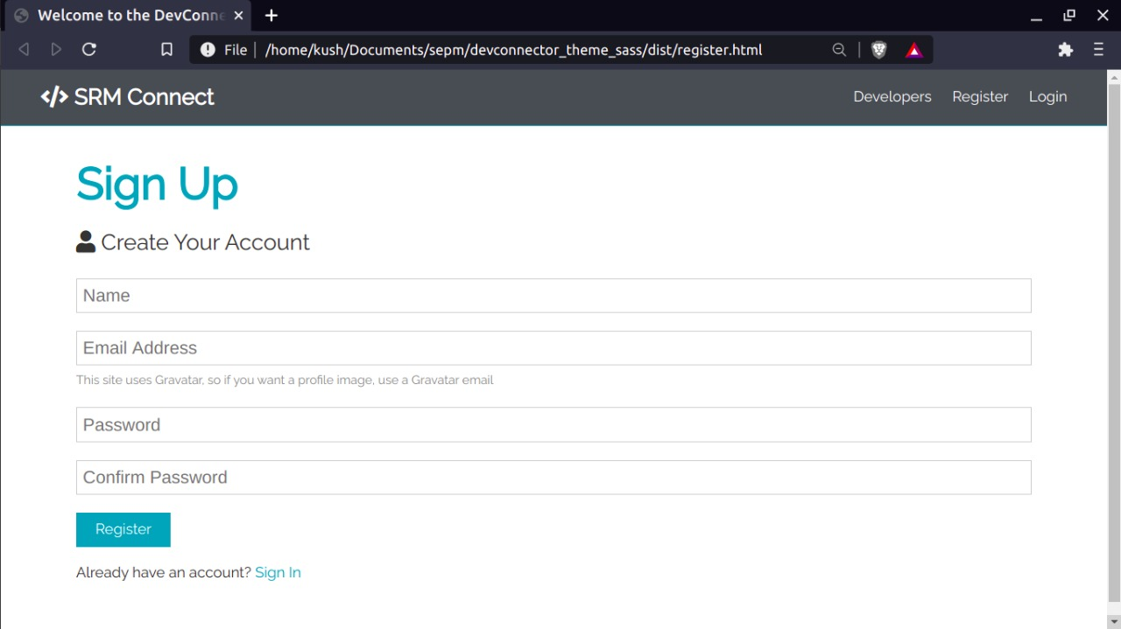
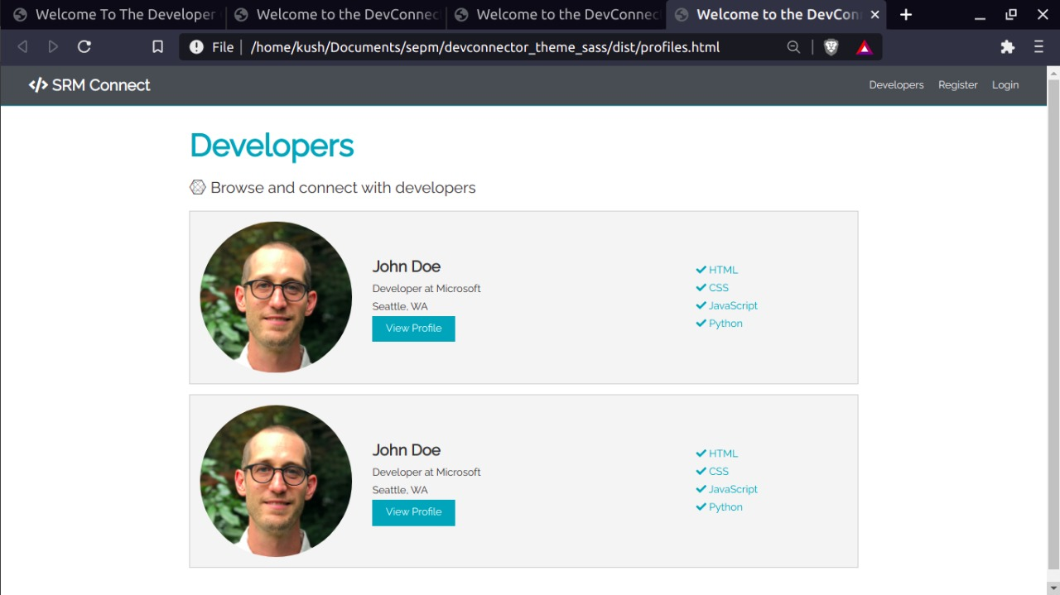
Sample Frontend

Slide 35
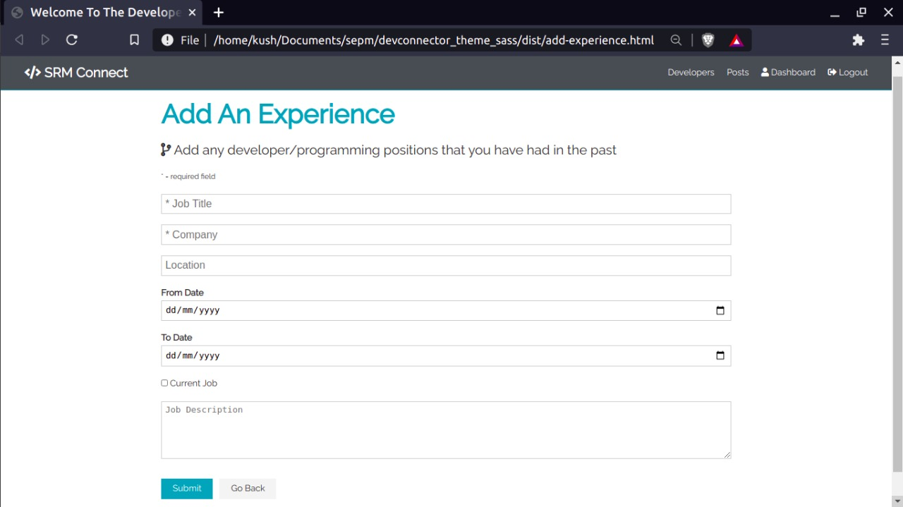
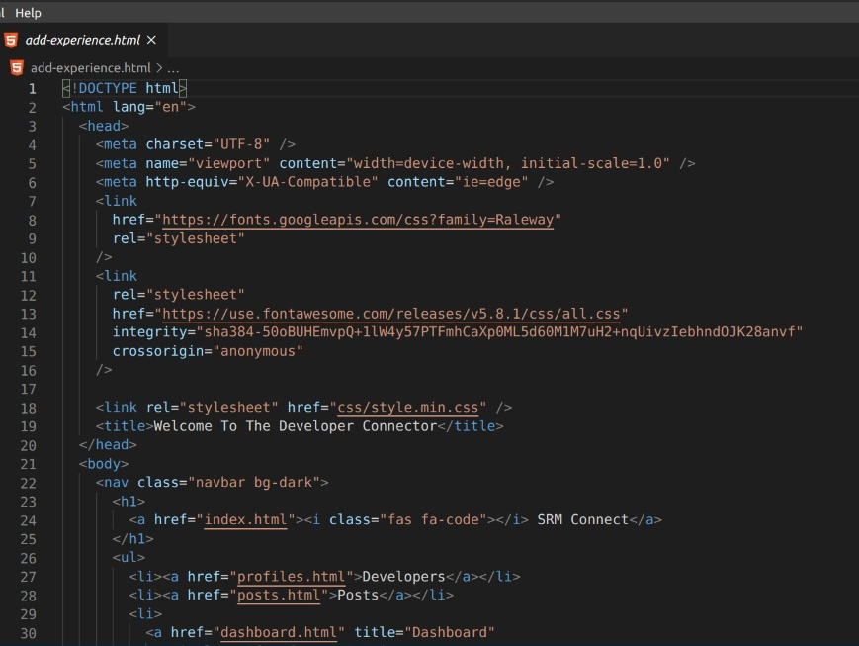

Slide 36
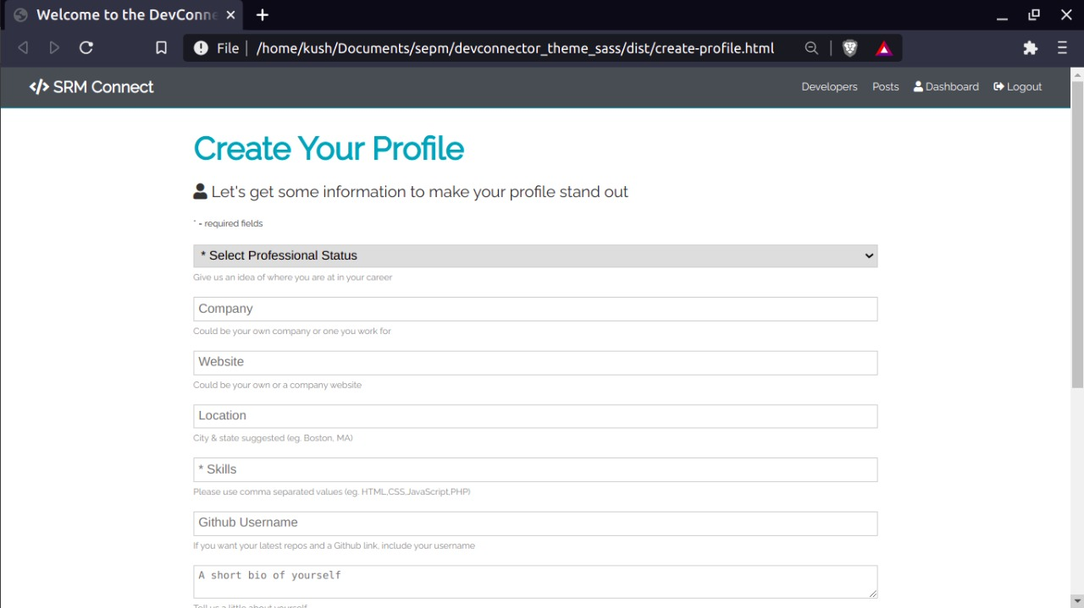
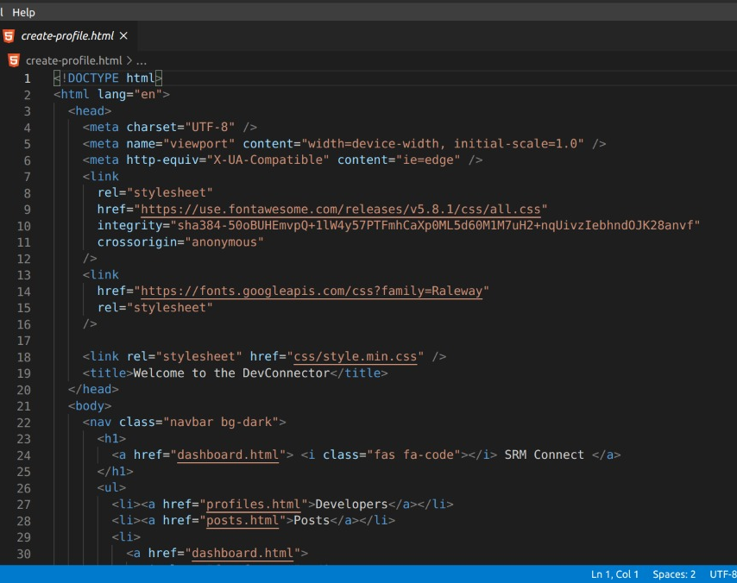

Slide 37
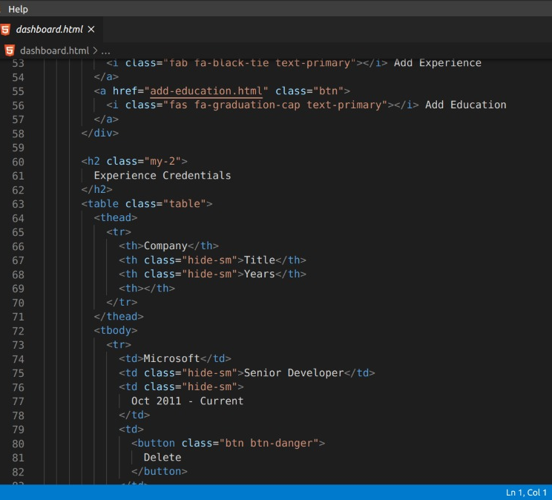

Slide 38
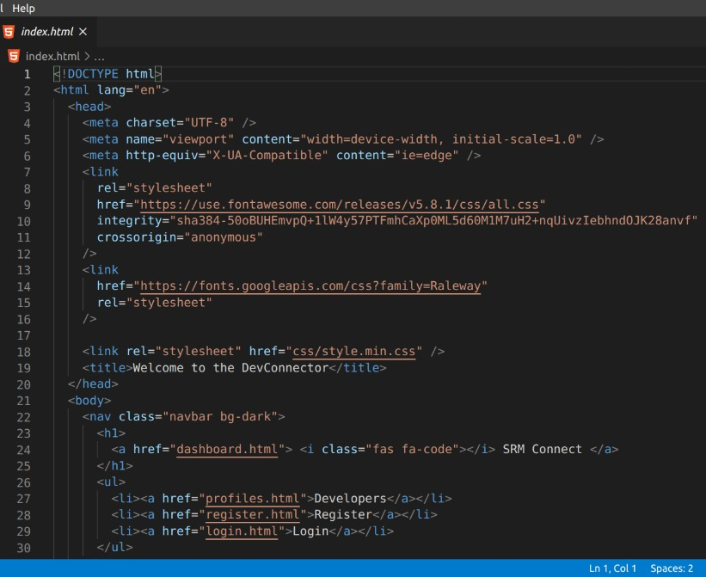

Slide 39
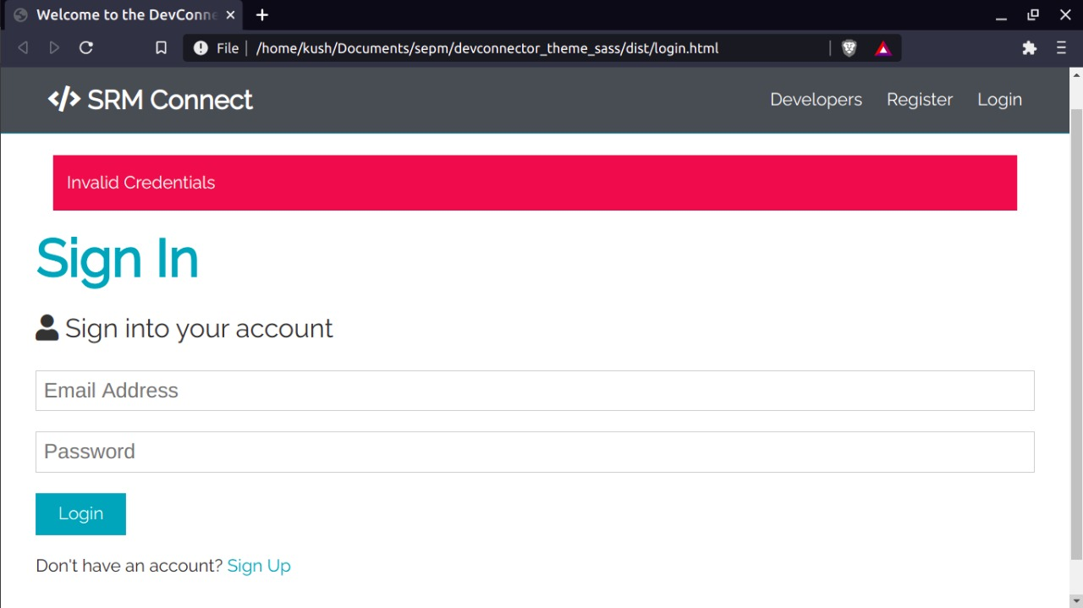
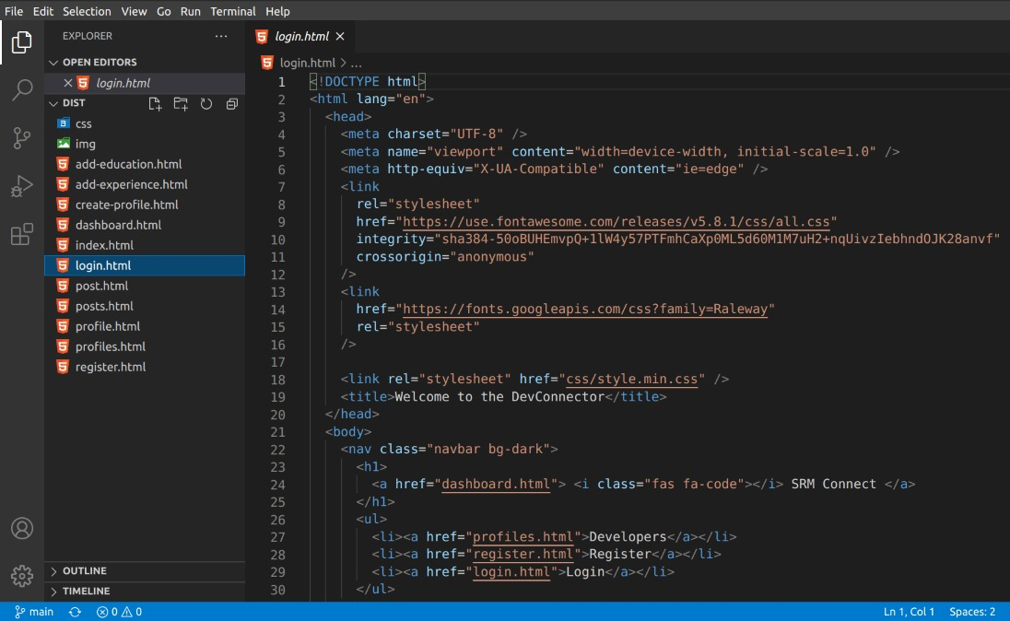

Slide 40
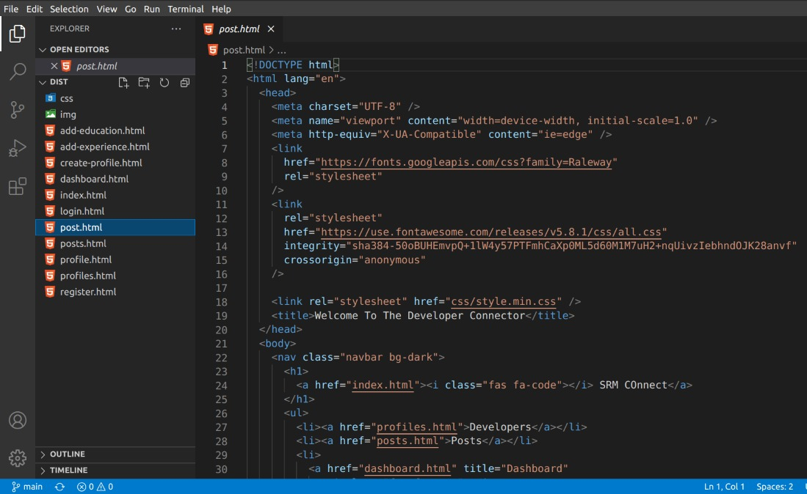

Slide 41
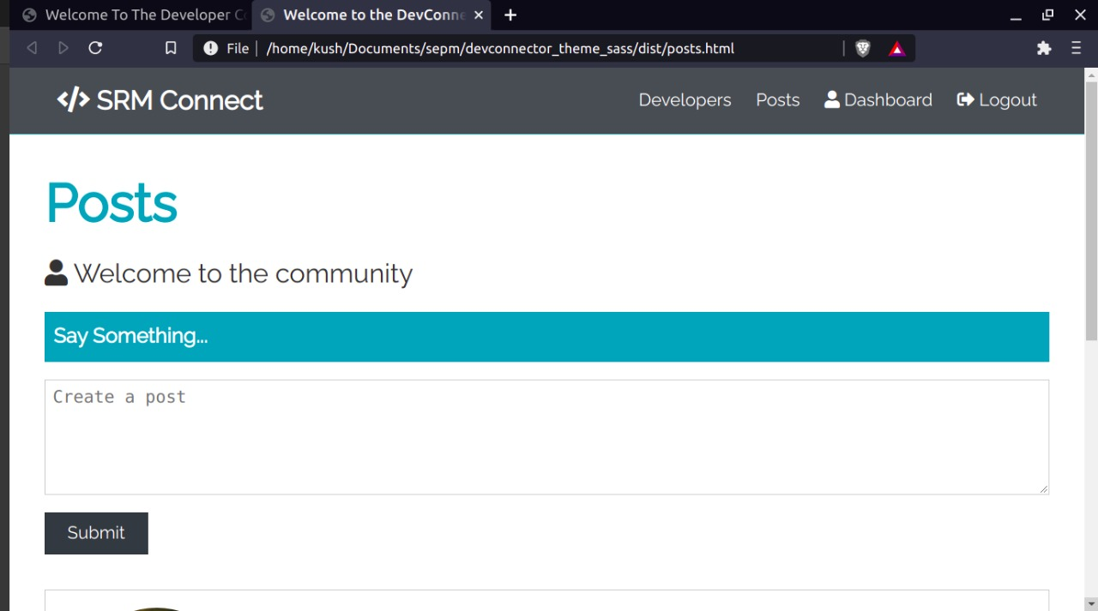
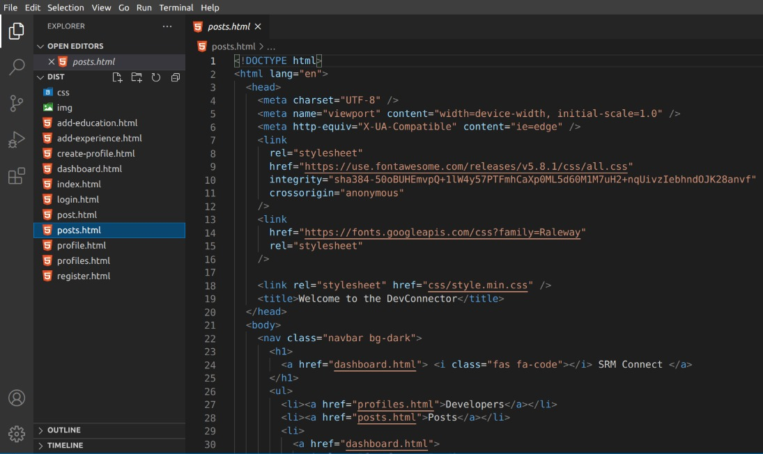

Slide 42
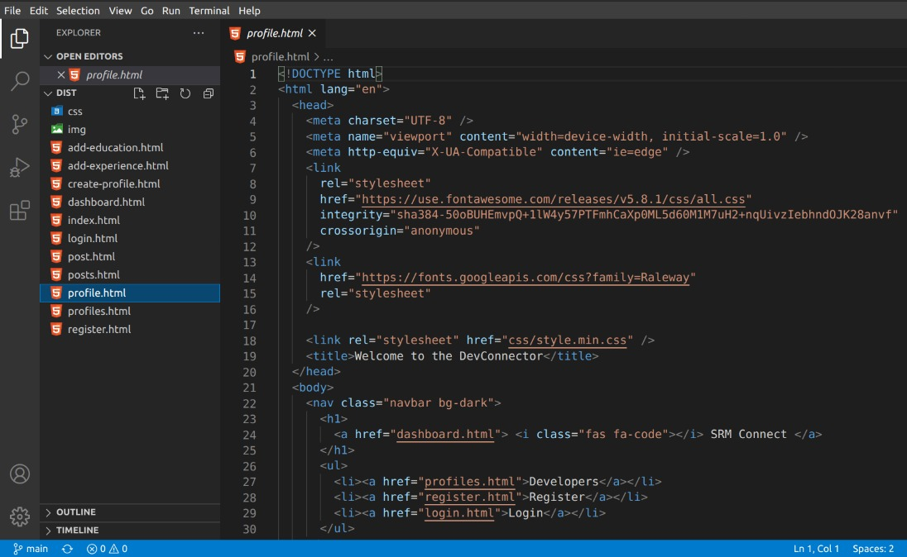

Slide 43
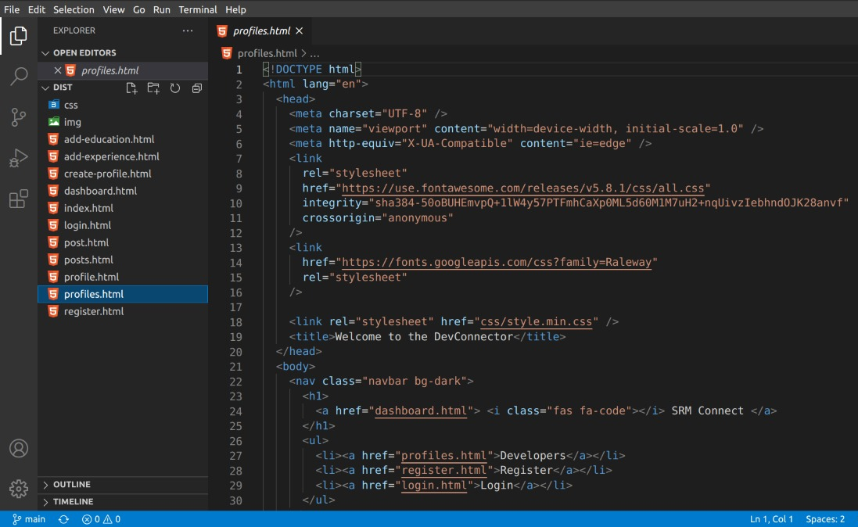

Slide 44
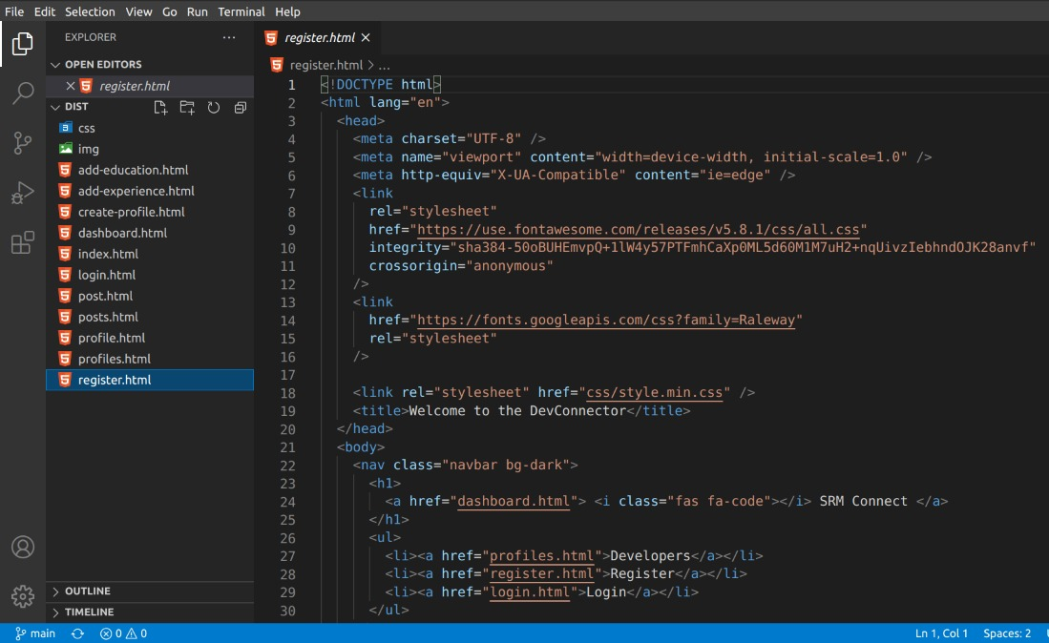

Slide 45
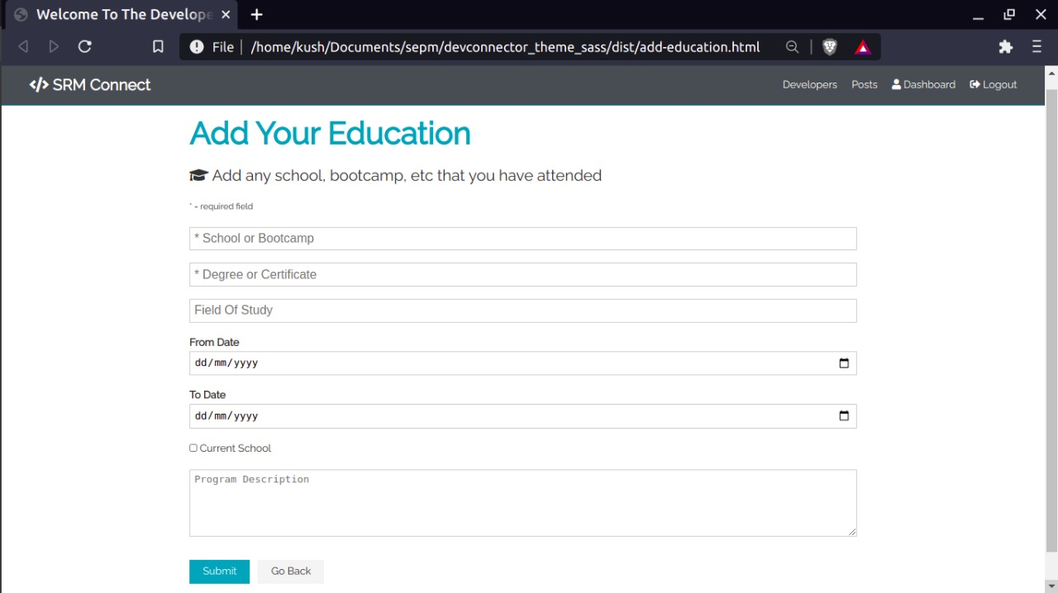
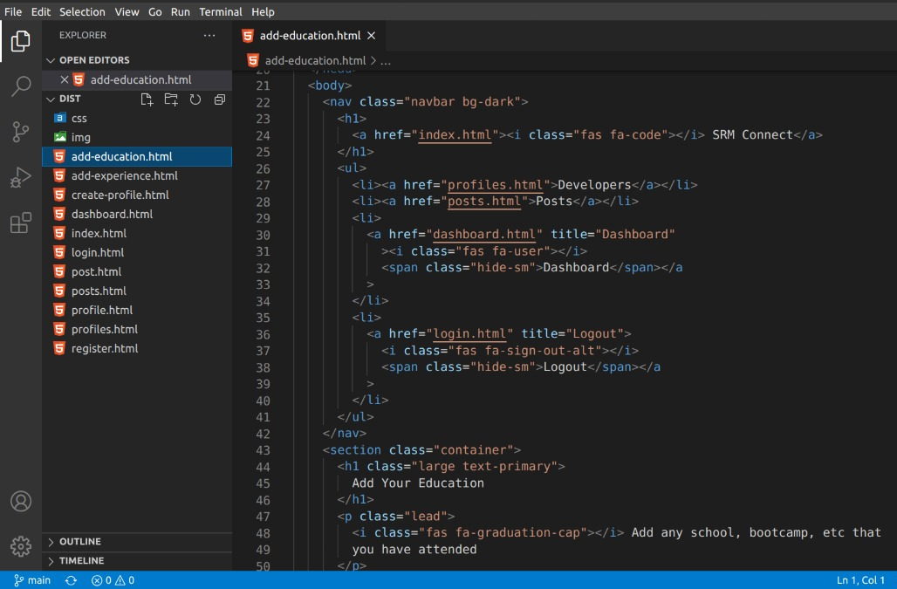

Slide 46


